Slide 1
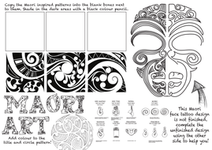
DID YOU KNOW…? MAORI ART IS A STYLE OF ART THAT ORIGINATED IN NEW ZELAND. THE NATIVE PEOPLE FROM NEW ZEALAND ARE ALSO CALLED, MAORI. THEY USE A LOT OF TRIBAL PATTERNS IN THEIR ART.
CREATE YOUR OWN MAORI PATTERNS!

Slide 2
