Slide 1
TONAL DRAWING
CHOOSE A SELECTION OF THESE IMAGES TO DRAW INCLUDING AS MUCH DETAIL AS POSSIBLE
REMEMBER: FILL THE PAGE AND INCLUDE LOTS OF CONTRAST TO YOUR SHADING!

Slide 2
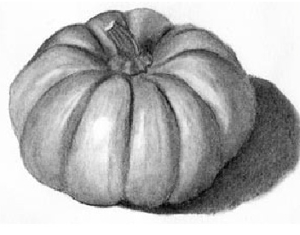

Slide 3
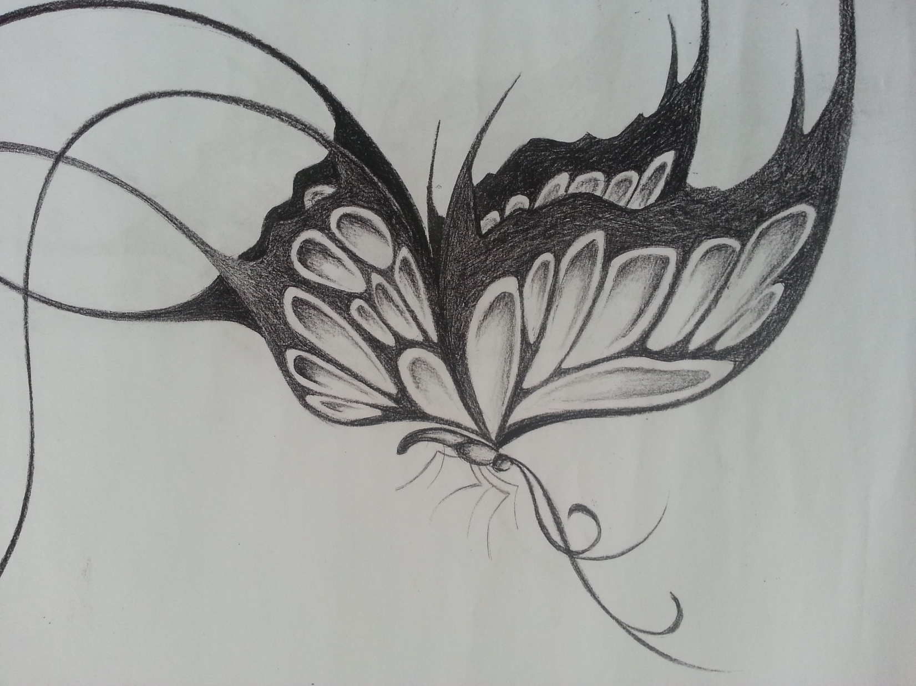

Slide 4


Slide 5
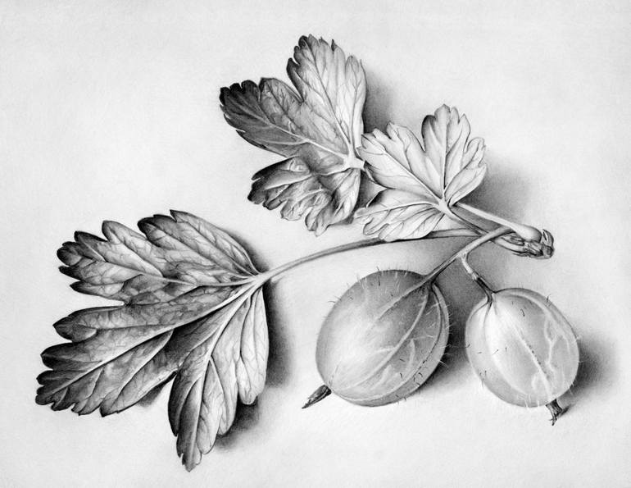

Slide 6
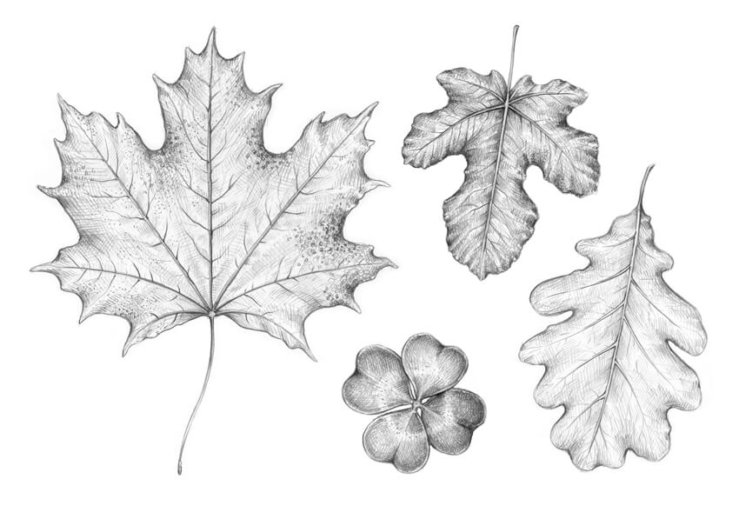

Slide 7
