Slide 1
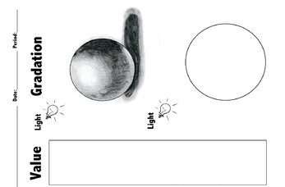
Try to add the shading here

Slide 2
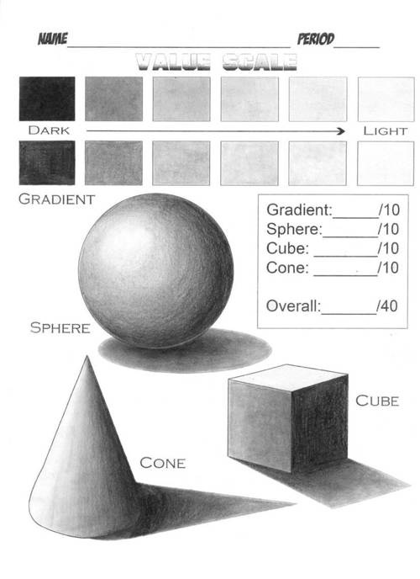
REDRAW THESE SOLIDS ON THE NEXT PAGE & ADD SHADING TO THEM

Slide 3
DRAW YOUR 3D SOLIDS ON THIS PAGE & ADD SHADING TO THEM…

