Slide 1
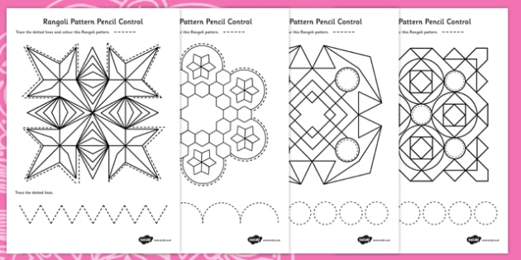
PLESASE COLOUR IN THIS PATTERN!
YOUR COLOURS DON’T HAVE TO BE EXACTLY THE SAME…
USING A RULER AND COMPASS TRY TO RECREATE THESE RANGOLI PATTERNS

Slide 2
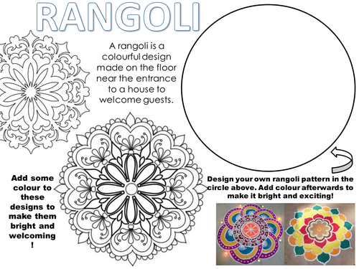
PLESASE COLOUR IN THIS PATTERN!
YOUR COLOURS DON’T HAVE TO BE EXACTLY THE SAME…

