Slide 1
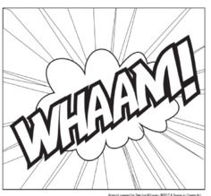
ONOMATOPOEIA WORDS: Words that suggest a noise or a sound…CRASH! SPLASH!
Colour in your onomatopoeia word with POP ART colours

Slide 2
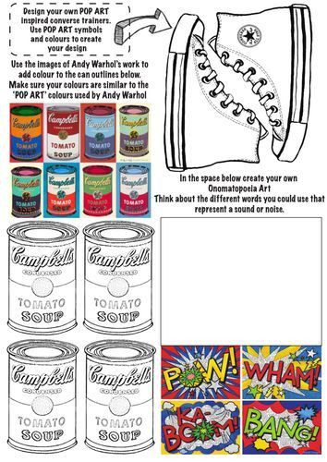
Design your own POP ART inspired converse trainers. Use POP ART symbols & colours to create your design
In the space below create your own onomatopoeia Art. Think about the different words you could use that represent a sound or noise

Slide 3
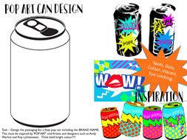
POP ART CAN DESIGN
Design your own funky coke!

